Slide 1
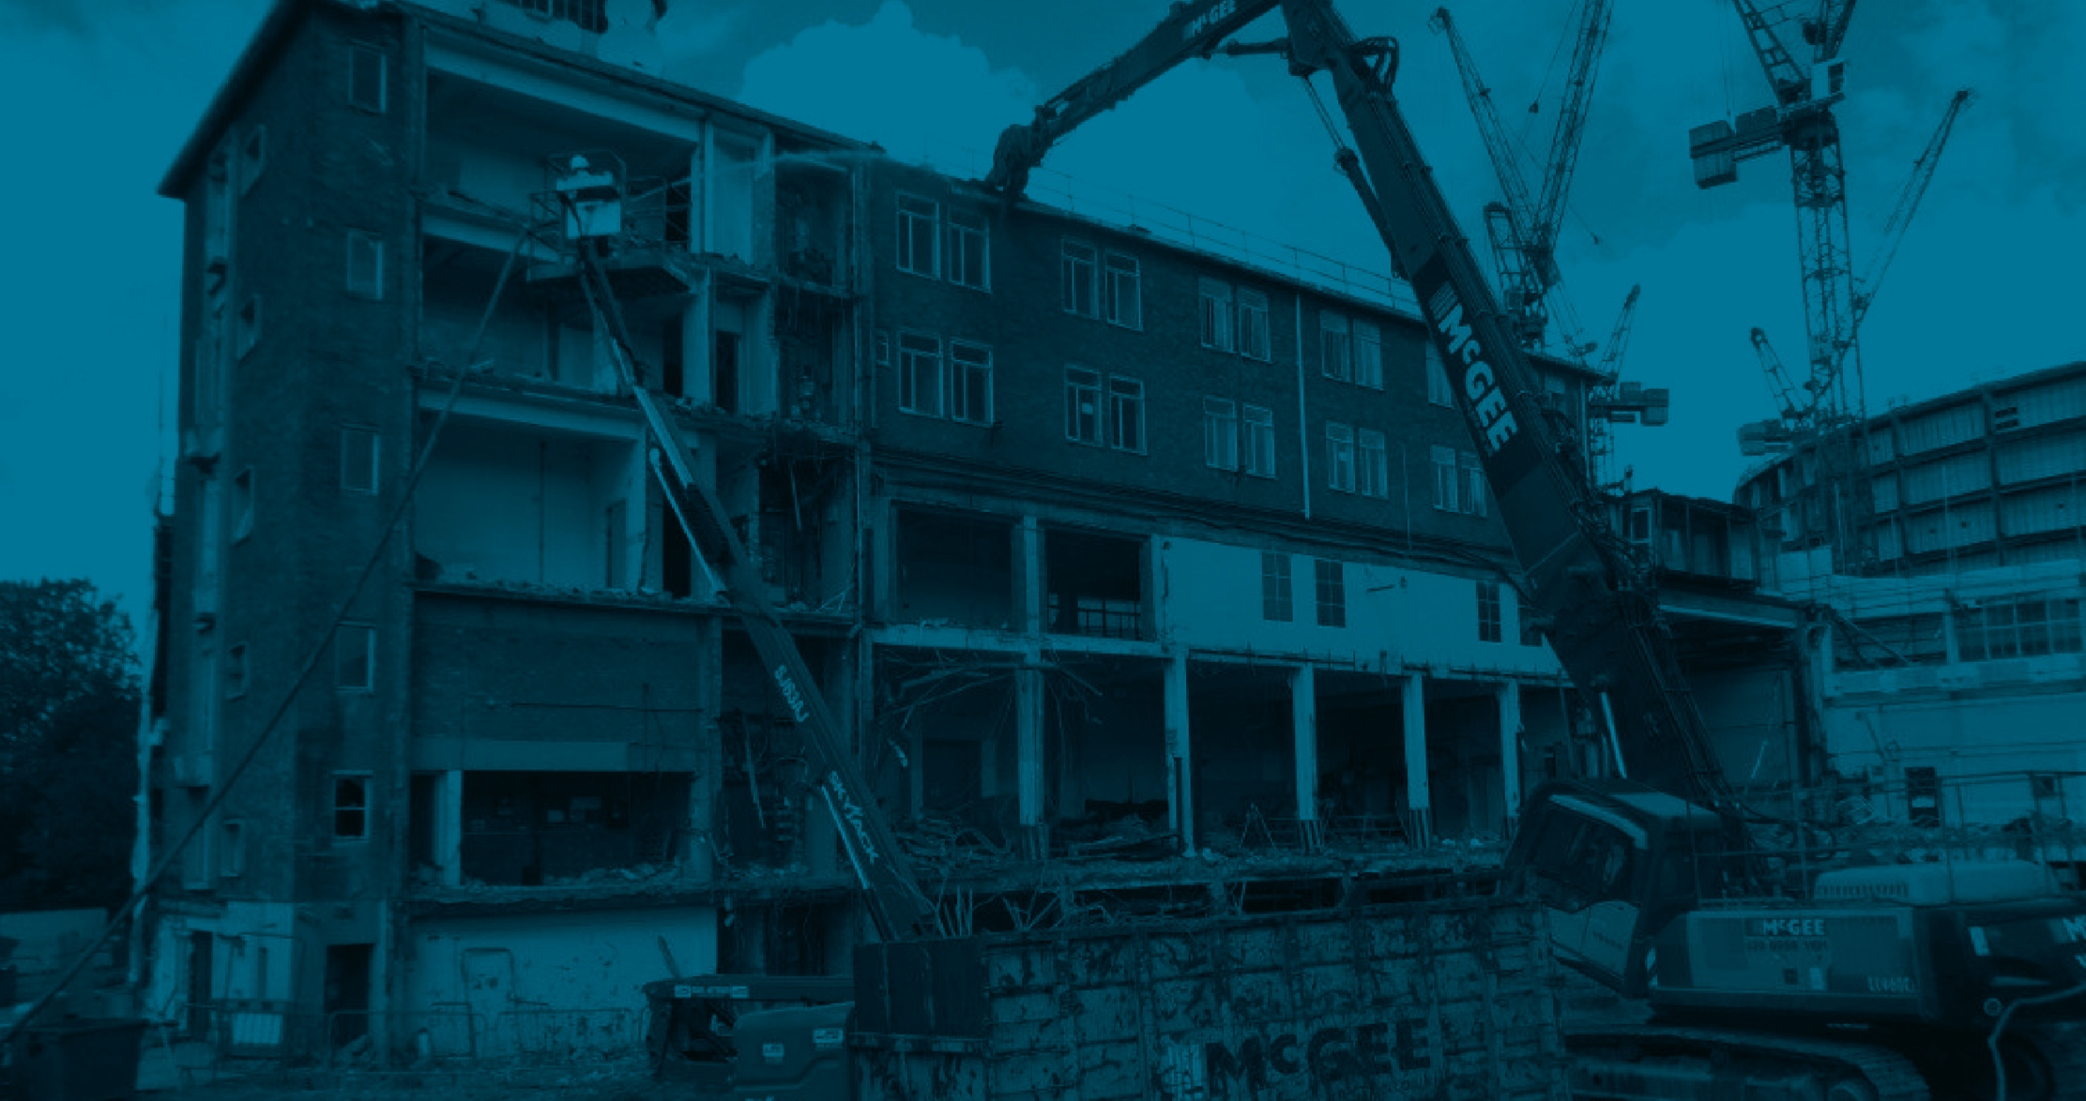
IMPORTANT NOTE TO CONSTRUCTION MANAGERS
Surveys have been undertaken to determine the at-risk areas for asbestos, lead and land contamination for example. Highly specialised control measures are needed for such dusts and not covered by this Toolbox Talk.
You have undertaken a task specific risk assessment and determined the control measures including a suitable type of respiratory protection.
If you are providing respiratory protection you have or will undergo face fit testing.

Slide 2
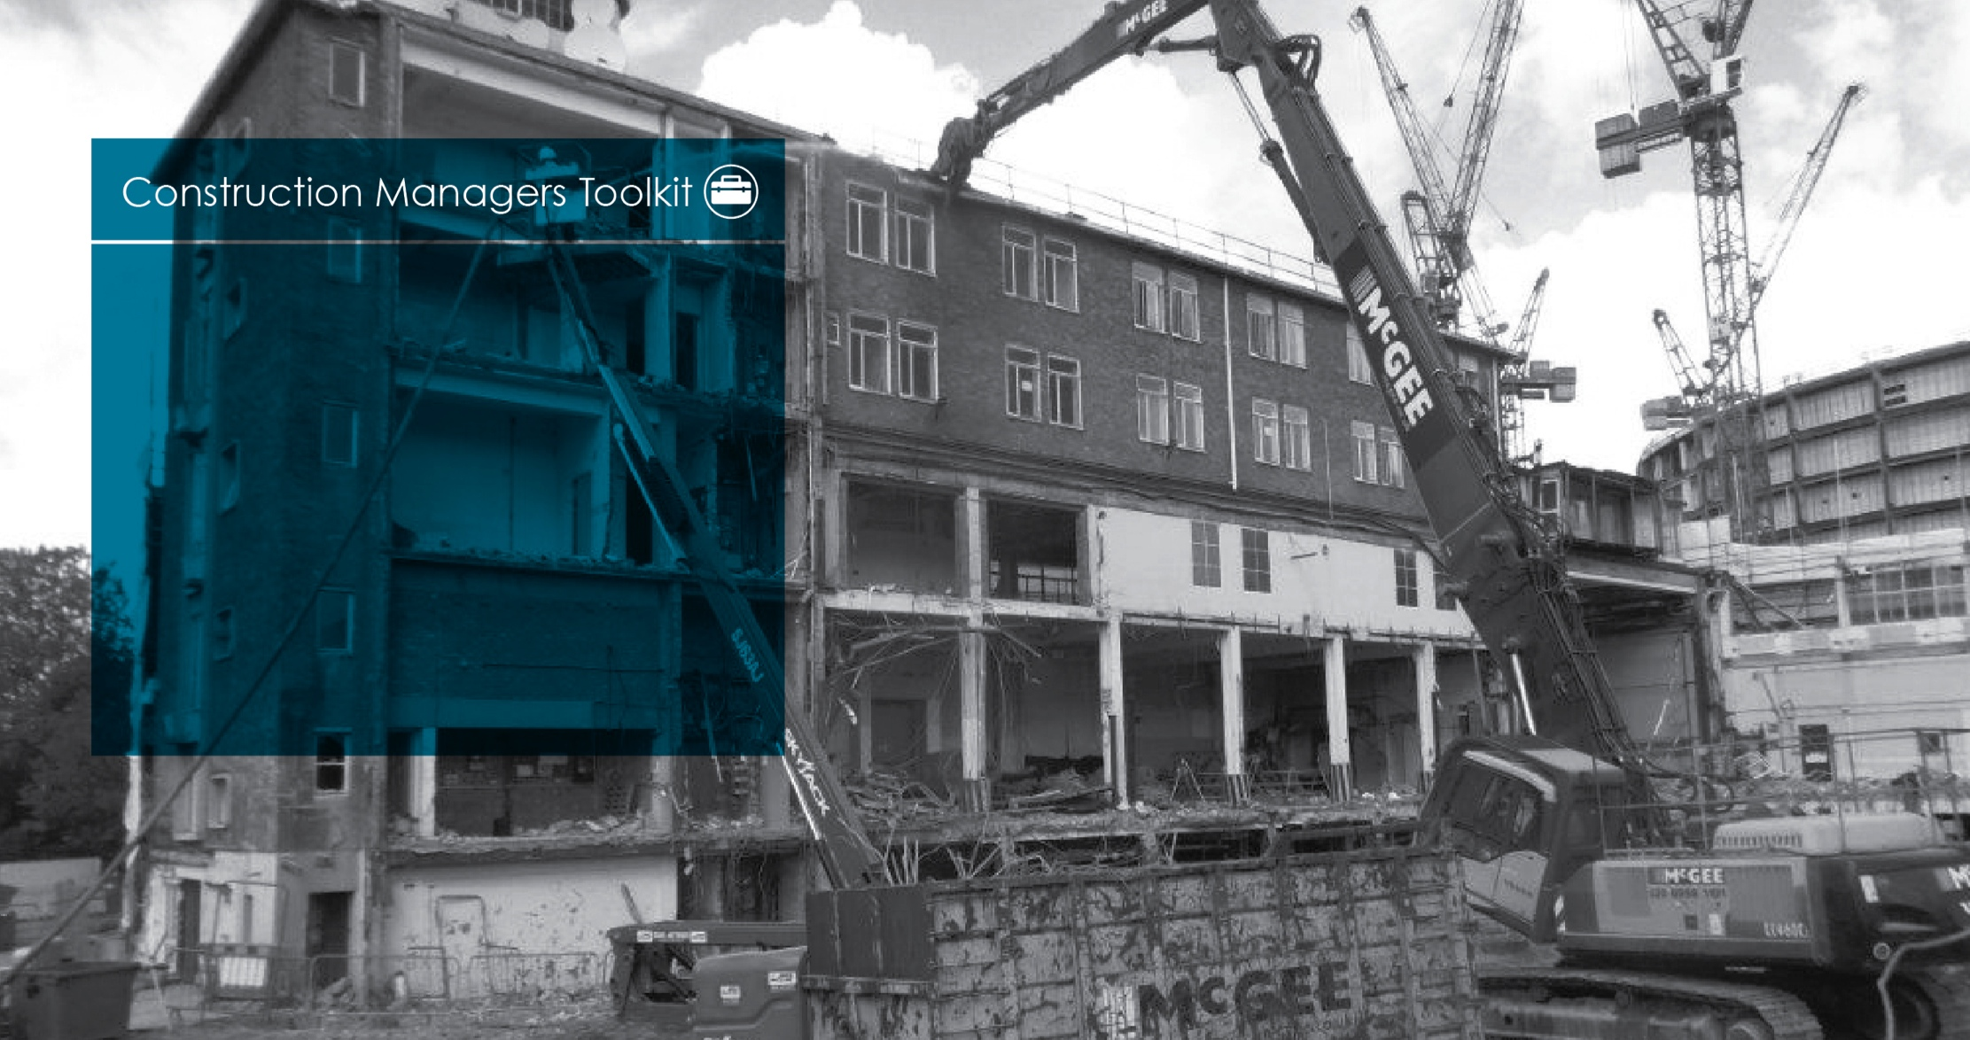
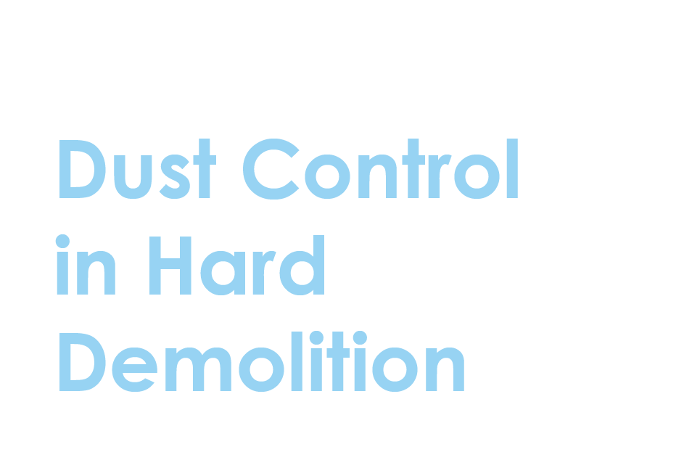

Slide 3
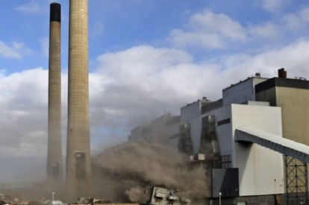
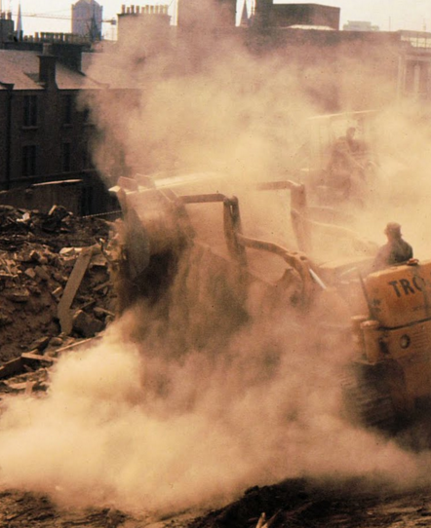
Demolition dust is commonly produced during the use of high-powered grinding, scabbling and breaking demolition machinery in ‘hard’ or structural demolition.
There are two main types of dust on a demolition site that can be harmful to your health. The first is silica dust which is a natural substance found in stone, rock, sand and clay but also present in concrete and mortars. When broken into fine particles, it is often referred to as respirable crystalline silica (RCS). RCS can be produced as a direct result of grinding, cutting and drilling.
The second category of dust is non-silica dust, which may be found in construction products such as gypsum, cement, limestone, marble, dolomite and wood dusts. It may also be mixed in with silica dust when cutting bricks, for example.
Bad practice picture required

Slide 4
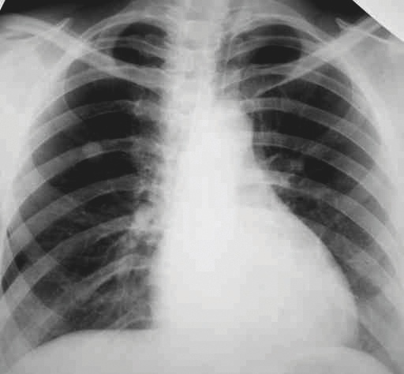
These dusts are not just a nuisance. They can seriously damage your lungs and airways, making it hard to breathe and lead a normal life. In some cases they are fatal.
The main dust-related diseases affecting construction workers are:
Lung cancer.
The lung disease silicosis.
Chronic obstructive pulmonary disease (COPD), where serious long-term lung damage causes conditions such as chronic bronchitis and emphysema.
Asthma.
Bad practice picture required

Slide 5
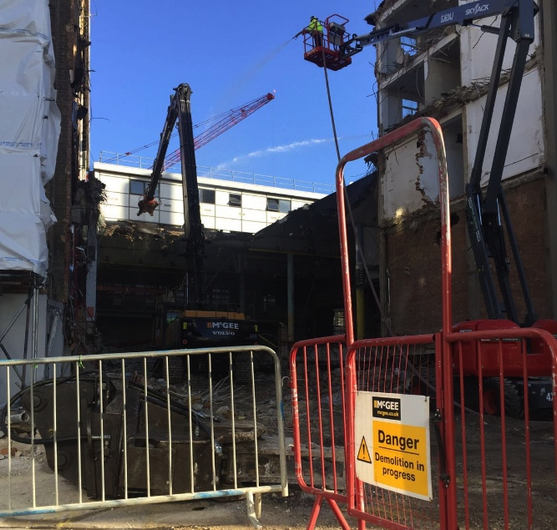
We can protect you from dust caused by hard demolition work in a number of ways:
Where possible, we will choose tools and equipment which don’t produce dust in the same way that cutting and grinding usually does. We will lift components out whole or break down in situ, etc.
We will provide water to damp down the dust, either as a knock down spray or by saturating an area before work starts. Saturation needs to be planned carefully because water runoff can cause serious damage to adjacent retained structures, as well as being a slip hazard.
We will provide exclusion zones to contain dust and minimise the number of people in the at-risk area. Where possible we will enclose the area by sheeting and screening to control the spread of dust and where necessary we will use extraction ventilation equipment to remove the dust at the source.

Slide 6
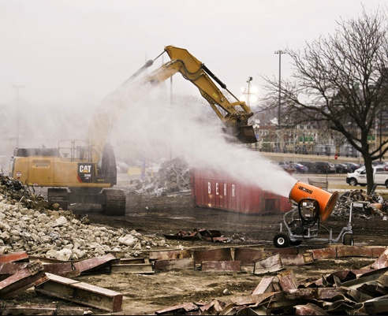
Follow the control measures as outlined in your risk assessment and method statement.
Make sure that you are not in the work area if you don’t need to be.
Warn those around you when you are creating dust.
Wear your respiratory protective equipment as directed.
Good practice picture required

Slide 7
1
What’s the problem with dust on demolition sites?
Demolition dust is not just a nuisance. It can seriously harm your health and prevent you from leading a full and active life.
2
What are the effects of breathing in demolition dust?
Dust related diseases affecting construction workers include lung cancer, silicosis, chronic obstructive pulmonary disease (COPD), such as chronic bronchitis and emphysema, and asthma.
3
Do you have everything you need to protect yourself?
Read and understand the risk assessment and method statement.
Be aware of dust, for example use work methods which generate the least dust as you’ve been shown and take note of exclusion zones for dusty work, keeping away if you don’t need to be there.
Use all control measures provided such as extraction equipment, water for damping down dust and your respiratory protective equipment.

Slide 8
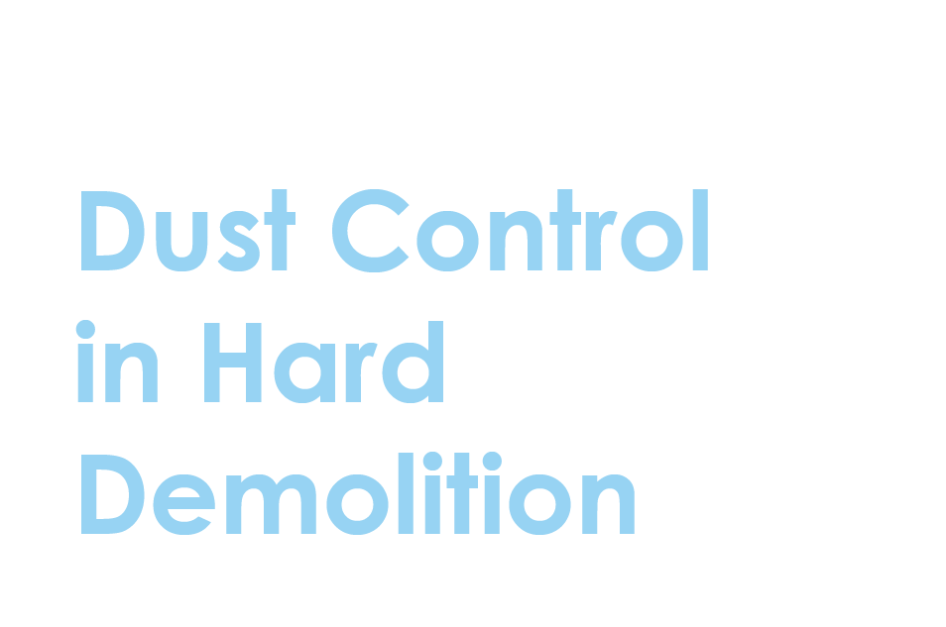

Slide 9
Visual standards demonstrate ‘what good looks like’.
They are intended to reinforce expectations of health and safety standards.

Slide 10
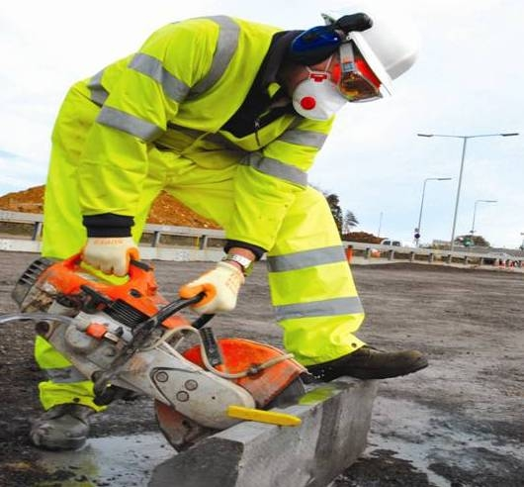
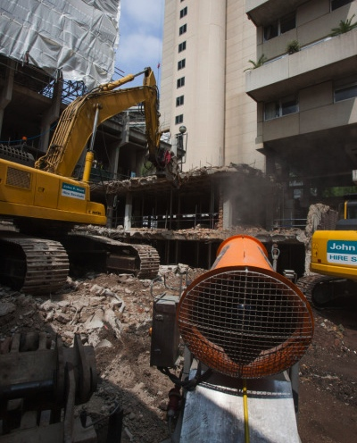
Exclusion zones are created to contain dust and minimise the exposure of workers.
Where possible, the work is designed to use tools and equipment which generate less dust.
Demolition dust is dampened down with water
Extraction ventilation equipment may be used to remove the dust at source.
Respirators (dust masks) of suitable standard are face fitted and worn for dusty work.
Permission to use image required from Mace

Slide 11
Sponsored by
Current titles in the Let’s Talk series
Diesel Fume
Dust Control in Hard Demolition
Dust Control in Soft Strip Demolition
Housekeeping
Painting with Brushes and Rollers
Painting with Brushes and Rollers
Removal of Lead-Based Paint
Silica
Water Suppression on Tools
Welding Fume
Wood Dust
www.breathefreely.org.uk

