Slide 1
IMPORTANT NOTE TO CONSTRUCTION MANAGERS
As far as possible ensure work is designed to avoid dusty tasks, e.g., by buying in wood pre-cut to the required dimensions.
You have undertaken a task specific risk assessment and determined the control measures including a suitable type of respiratory protection.
If you are providing respiratory protection you have, or will arrange face fit testing.

Slide 3
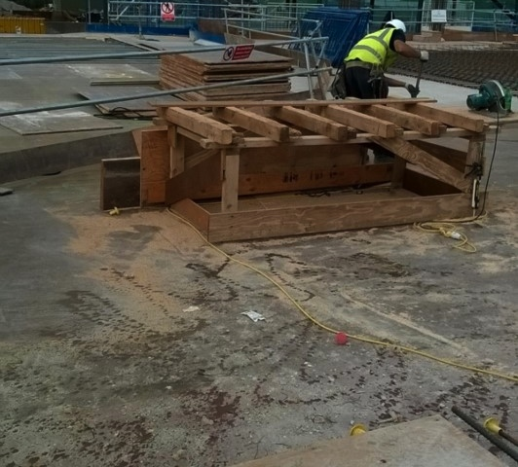
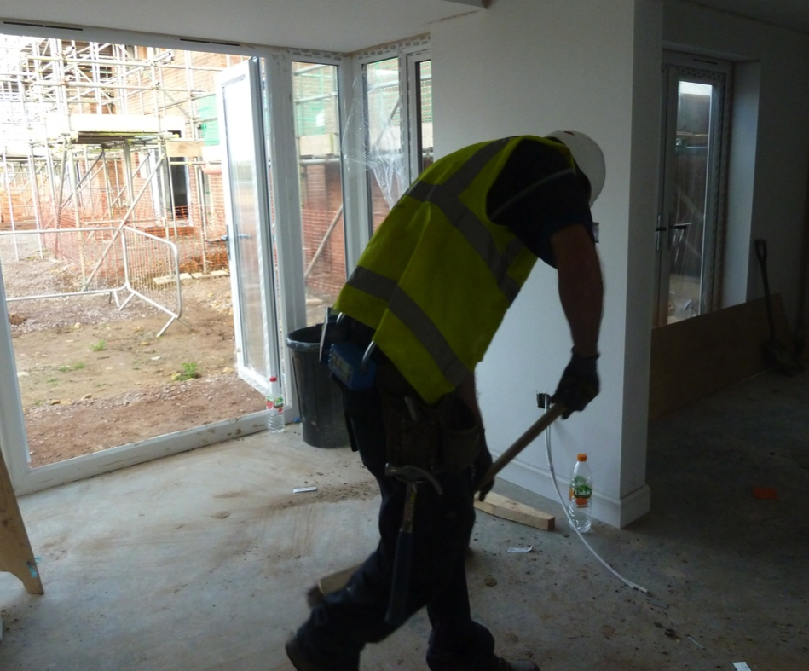
Wood dust is created when working on:
Softwood
Hardwood
Wood based products like MDF, chipboard and plywood

Slide 4
Breathing in wood dust can seriously harm the health of your lungs:
All wood dust, including the dust from composite board materials (such as MDF and chipboard), can cause asthma. Some types of wood dust put the worker at a higher risk of asthma, such as western red cedar, iroko, ramin, oak or mahogany. This serious disease can significantly affect your quality of life, making it difficult to play sports, or even take moderate exercise. It could also mean that you can no longer work in the construction sector, or other industries which involve wood working.
Some hardwoods also have the potential to cause cancer.
Wood dust exposure may also cause dermatitis. The dermatitis risk is high for softwoods.

Slide 5
Employers in Great Britain have a duty under the Control of Substances to Health system (COSHH) to reduce wood dust exposures to a level which is as low as reasonably practicable.
Common tasks which can cause wood dust exposures include:
Cutting, sanding, routing, planing and drilling.
Work with power tools which usually generate more dust than hand tools, although hand sanding can be a very dusty activity.
The cleaning up of work areas and equipment after wood working.

Slide 6
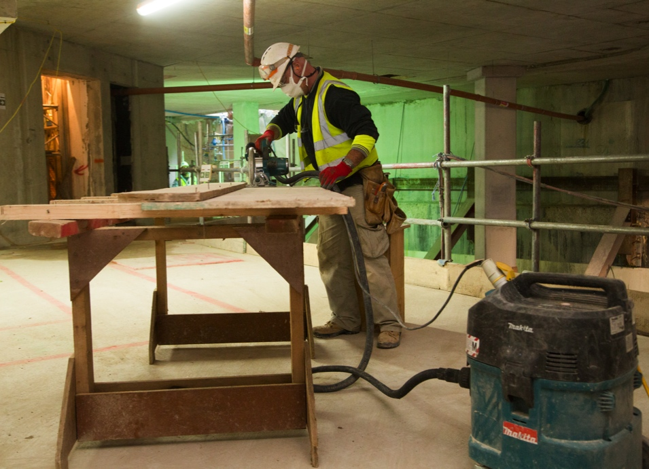
Where power tools are used on-site for wood working, dust exposure can be controlled by using local exhaust ventilation (LEV). Most commonly in construction this will involve on-tool dust extraction consisting of:
The captor hood - this captures the dust as it is produced and is often manufactured as part of the power tool but can also be retro-fitted to existing equipment. Some LEV systems may consist of a receptor hood design as well, where the dust cloud is projected into the receiving hood. E.g. a table saw fitted with a captor hood along it's blade guard but also a receptor hood placed at the back of the saw to receive the dust cloud.
The extraction unit - this is a portable unit which removes the dust from the captor hood, filters it and then stores it for safe disposal.
Extraction systems need proper checking and maintenance systems to allow them to keep working efficiently.

Slide 7
In addition to LEV, often respiratory protective equipment (RPE, i.e. dust masks) will have to be provided as well. We need to make sure that your RPE is:
Adequate for the amount and type of wood dust as in FFP3 or P3 standard as per your risk assessment.
Suitable for the work because disposable masks or half-masks can become uncomfortable to wear for long periods (powered RPE may be better when people are working for more than an hour without a break).
Fitted for individual users.
Regularly checked and maintained.

Slide 8
Read and understand the risk assessment before starting work.
Use all exposure controls that are provided.
Report any damaged or defective equipment immediately.
Report any breathing difficulties or chest tightness.
Challenge colleagues who are not following good practice in controlling airborne dust.
In case of RPE you will need to:
Wear your PPE correctly – anyone using tight fitting masks needs to be clean shaven.
Store your PPE in a clean place when it’s not in use.
Check and maintain re-usable RPE in accordance with your training and systems.
When cleaning up, remember:
Wood dust should be cleaned up using a suitably filtered vacuum cleaner.
Sweeping brushes should be avoided as they create unnecessary airborne dust.
Settled dust contains the fine particles that are most likely to damage the lungs.

Slide 9
1
Where might you be exposed to wood dust on a construction site?
Wood dust is created when working on softwood, hardwood and wood-based products like MDF and plywood.
2
What are the main lung-related health effects of uncontrolled exposure to wood dust?
Lung damage, including asthma and cancer.
3
Do you have everything you need to protect yourself?
Read and understand the risk assessment.
Understand the need for extraction on power tools.
Know how and when to wear your RPE.
Avoid dry sweeping when cleaning up wood dust.

Slide 11
Visual standards demonstrate ‘what good looks like’.
They are intended to reinforce expectations of health and safety standards.

Slide 12
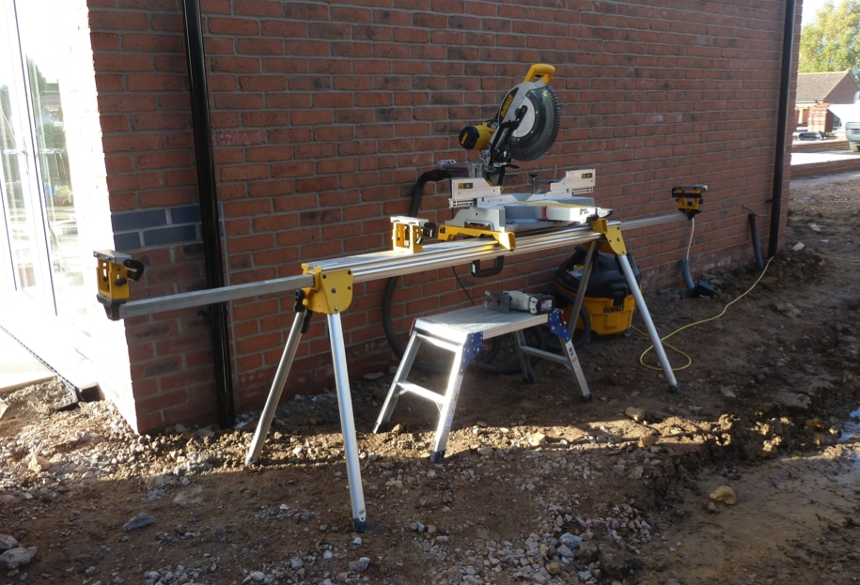
Power tools are fitted with on-tool extraction to capture dust at source and/or receive the dust cloud projected into the receptor hood.
RPE is worn for dusty work, as required by the assessment for the task.
RPE is checked so that they are suitable for individual workers.
Picture illustrates chop saw fitted with dust extraction.

Slide 13
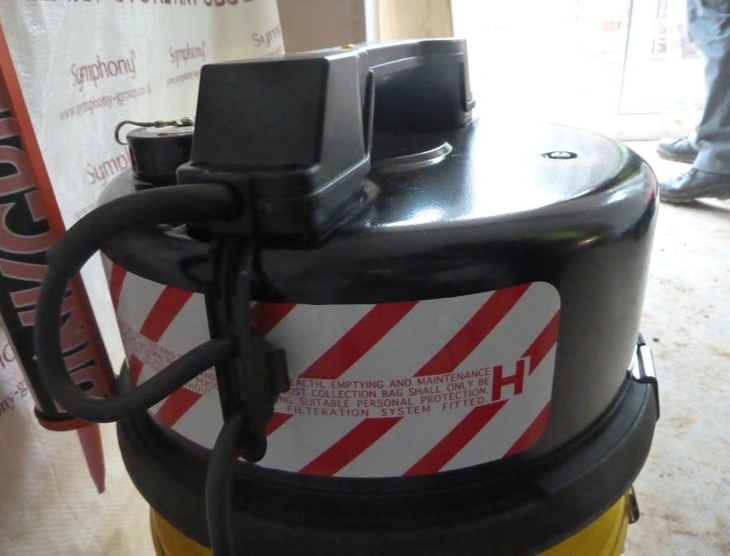
Vacuum cleaners are used to clean up, not sweeping brushes.
Vacuum systems used for extraction are of M class or H class.
Picture illustrates H class vacuum for use with on-tool extraction and for cleaning up.

Slide 14
Sponsored by
Current titles in the Toolbox Talks series
Diesel Fume
Dust Control in Hard Demolition
Dust Control in Soft Strip Demolition
Housekeeping
Painting with Brushes and Rollers
Painting with Brushes and Rollers
Removal of Lead-Based Paint
Silica
Water Suppression on Tools
Welding Fume
Wood Dust
www.breathefreely.org.uk

